Slide 1


Recommendation System
on MovieLens20M
Final Presentation
Web Mining Project Group 9
31.05.2022

Slide 2
Agenda
Dataset
1
Recommendation System
2
Results
3
4

Slide 3
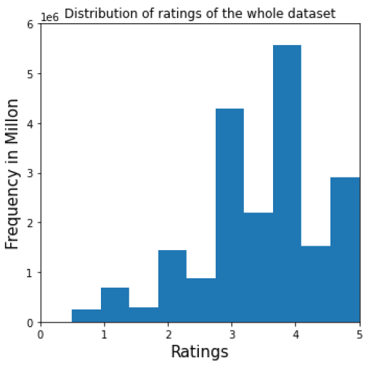
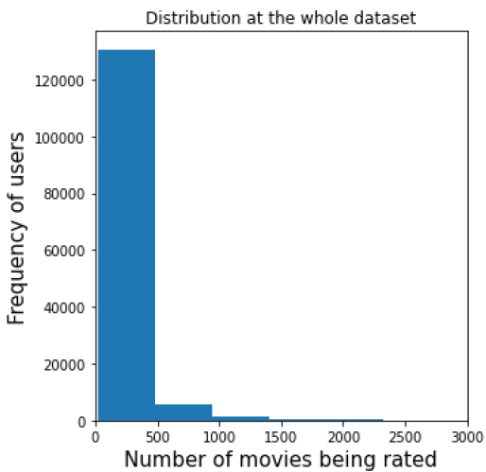
DATASET
MovieLens20M
Data Analysis
movies.csv
ratings.csv
tags.csv
genome-scores.csv
genome-tags.csv
links.csv
20M ratings
38K users
27K movies
1128 tag relevance scores for each movie
All users have > 20 ratings
Ratings from 0 to 5
Most ratings between 3 and 4 points
Least ratings between 0 and 1
Most users have rated
0 to 500 movies

Slide 4
DATASET
Imdb
Data Analysis
The Problem with MovieLens:
It does not contain very much information beyond the actual ratings which
limits the number of features that can be used in Content-based Recommendation
Solution
Combine MovieLens and Imdb dataset
Imdb contains
title.akas.tsv,
title.basics.tsv,
title.crew.tsv,
title.episode.tsv
link.csv matches MovieLens Ids with Imdb Ids
title.principals.tsv,
title.ratings.tsv,
name.basics.tsv

Slide 5
DATASET
MovieLens20M
Preprocessing
No missing values
No duplicates
19 missing release years that were researched and added to the title for completeness
1
 | movieId | title | genres
0 | 1 | Toy Story (1995) | Adventure|Animation|Children|Comedy|Fantasy
1 | 2 | Jumanji (1995) | Adventure|Children|Fantasy
2 | 3 | Grumpier Old Men (1995) | Comedy|Romance
2
 | movieId | title | year | year_category | Adventure | Animation | … | Film-Noir
0 | 1 | Toy Story | 1995 | 2 | 1.0 | 1.0 | … | 0.0
1 | 2 | Jumanji | 1995 | 2 | 1.0 | 0.0 | … | 0.0
2 | 3 | Grumpier Old Men | 1995 | 2 | 0.0 | 0.0 | … | 0.0
Downsizing strategy to comply to RAM capacity constraints → 7.5M ratings
Train-Test-Split: “Leave One Last Basket” method
3

Slide 6
Agenda
Dataset
1
Recommendation System
2
Results
3
4

Slide 7








RECOMMENDATION SYSTEM
Hybrid Recommendation System
Memory-based
Collaborative
Filtering
- Item-based
Memory-based
Collaborative
Filtering
- User-based
Model-based
Collaborative Filtering
Content-based
Filtering
- Directors
Hybrid Recommender
Content-based
Filtering
- Movie Genre
Content-based
Filtering
- Release Year
Content-based
Filtering
- Tag Relevance
Score
Content-based
Filtering
- Main Actors

Slide 8
DATASET
Parameter Optimisation
Algorithm | Parameter | MAE | RMSE
KNNBasic | k=10, sim=cosine, item-based | 0.716971 | 0.943522
 | k=20, sim=cosine, item-based | 0.697669 | 0.919404
 | k=50, sim=cosine, item-based | 0.686921 | 0.906579
 | k=20, sim=person, user-based | 0.684907 | 0.881193
KNNWithMeans | k=20, sim=cosine, item-based | 0.618325 | 0.813355
SVD | n=30 | 0.568832 | 0.746386
 | n=50 | 0.567891 | 0.745352
 | n=100 | 0.567783 | 0.745401
 | n=150 | 0.568548 | 0.74629
NMF | n=15 | 0.634066 | 0.825956
 | n=30 | 0.656528 | 0.868169
Recommender | top_n | MAE | RMSE
Movie Genre | 2 | 0.8460 | 1.0920
 | 3 | 0.8071 | 1.0344
 | 4 | 0.7867 | 1.0045
 | 5 | 0.7742 | 0.9862
 | 6 | 0.6806 | 0.8704
 | 7 | 0.6788 | 0.8685
Tag Relevance Score | 2 | 0.3777 | 0.5167
 | 3 | 0.4660 | 0.6119
 | 4 | 0.5030 | 0.6549
 | 5 | 0.5261 | 0.6821
 | 6 | 0.5419 | 0.7012
 | 7 | 0.5513 | 0.7123

Slide 9
Agenda
Dataset
1
Recommendation System
2
Results
3
4

Slide 10
Results
Evaluation and Results
Single Recommenders
Short Disclaimer:
CB & Hybrid Recommender were only tested on a smaller sample (40K ratings)
Combinations | MAE | RMSE | NDCG@10 | NDCG@100
User-based CF | 2.5325 | 2.7447 | 0.9096 | 0.9096
Item-based CF | 2.5175 | 2.7271 | 0.9511 | 0.9337
Model-based CF | 0.5614 | 0.7377 | 0.9779 | 0.9779
First on entire set
User-based CF | 2.4509 | 2.6675 | 0.8866 | 0.8714
Item-based CF | 2.4373 | 2.6469 | 0.8929 | 0.8815
Model-based CF | 1.0370 | 1.3095 | 0.6300 | 0.6576
Genre CB | 0.7570 | 0.9695 | 0.8474 | 0.8304
Release Year CB | 0.7510 | 0.9520 | 0.9435 | 0.8677
Tag Relevance CB | 0.7077 | 0.9387 | 0.8984 | 0.8759
First on small set

Slide 11


Results
Evaluation and Results
Hybrid Recommenders
Combinations | MAE | RMSE | NDCG@10 | NDCG@100
All 3 CB & All 3 CF | 1.0188 | 1.1988 | 0.9810 | 0.9207
All 3 CB & Model-based CF | 0.7176 | 0.9042 | 0.8988 | 0.8698
All 3 CB | 0.6783 | 0.8659 | 0.8701 | 0.8823
Baseline | 0.7075 | 0.9082 | 0.8758 | 0.8758
The NDCG@K Problem
NDCG ranges between 0 and 1, where 1 = optimal value
NDCG results are suspiciously close to the optimal value: [0.8304, 0.9810]
Except of one outlier: Model-based CF on entire testset which has best MAE & RMSE
Highest Ranked Papers on PapersWithCode:
NDCG@100: 0.448 (VASP)
NDCG@10:0 0.6404 (HyperML)
https://paperswithcode.com/sota/collaborative-filtering-on-movielens-20m

Slide 12
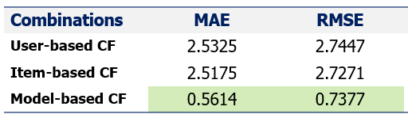
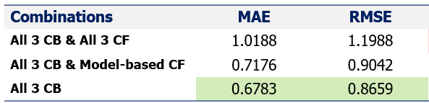
Results
Evaluation and Results
Benchmarks
Reminder
MovieLens10M
Bayesian timeSVD++ flipped: 0.7485
Bayesian timeSVD++: 0.7523
Bayesian SVD++: 0.7563
MRMA: 0.7634
MovieLens1M
GLocal-K: 0.8227
Sparse FC: 0.824
CF-NADE: 0.829
IMC-GAE: 0.829
MovieLens20M
GRAEM: 0.7887
MovieLens400K
GHRS: 0.887
GLocal-K: 0.8889
MG-GAT. 0.890
GraphRec + Feat: 0.897
https://paperswithcode.com/task/recommendation-systems

Slide 13
Q&A

